Slide 1
Trash or Treasure: Guidance on Retaining Your Office Records
  Eric Kalmin
  DIRECTOR, Records management & Information practices
  Office of legal affairs

Slide 2
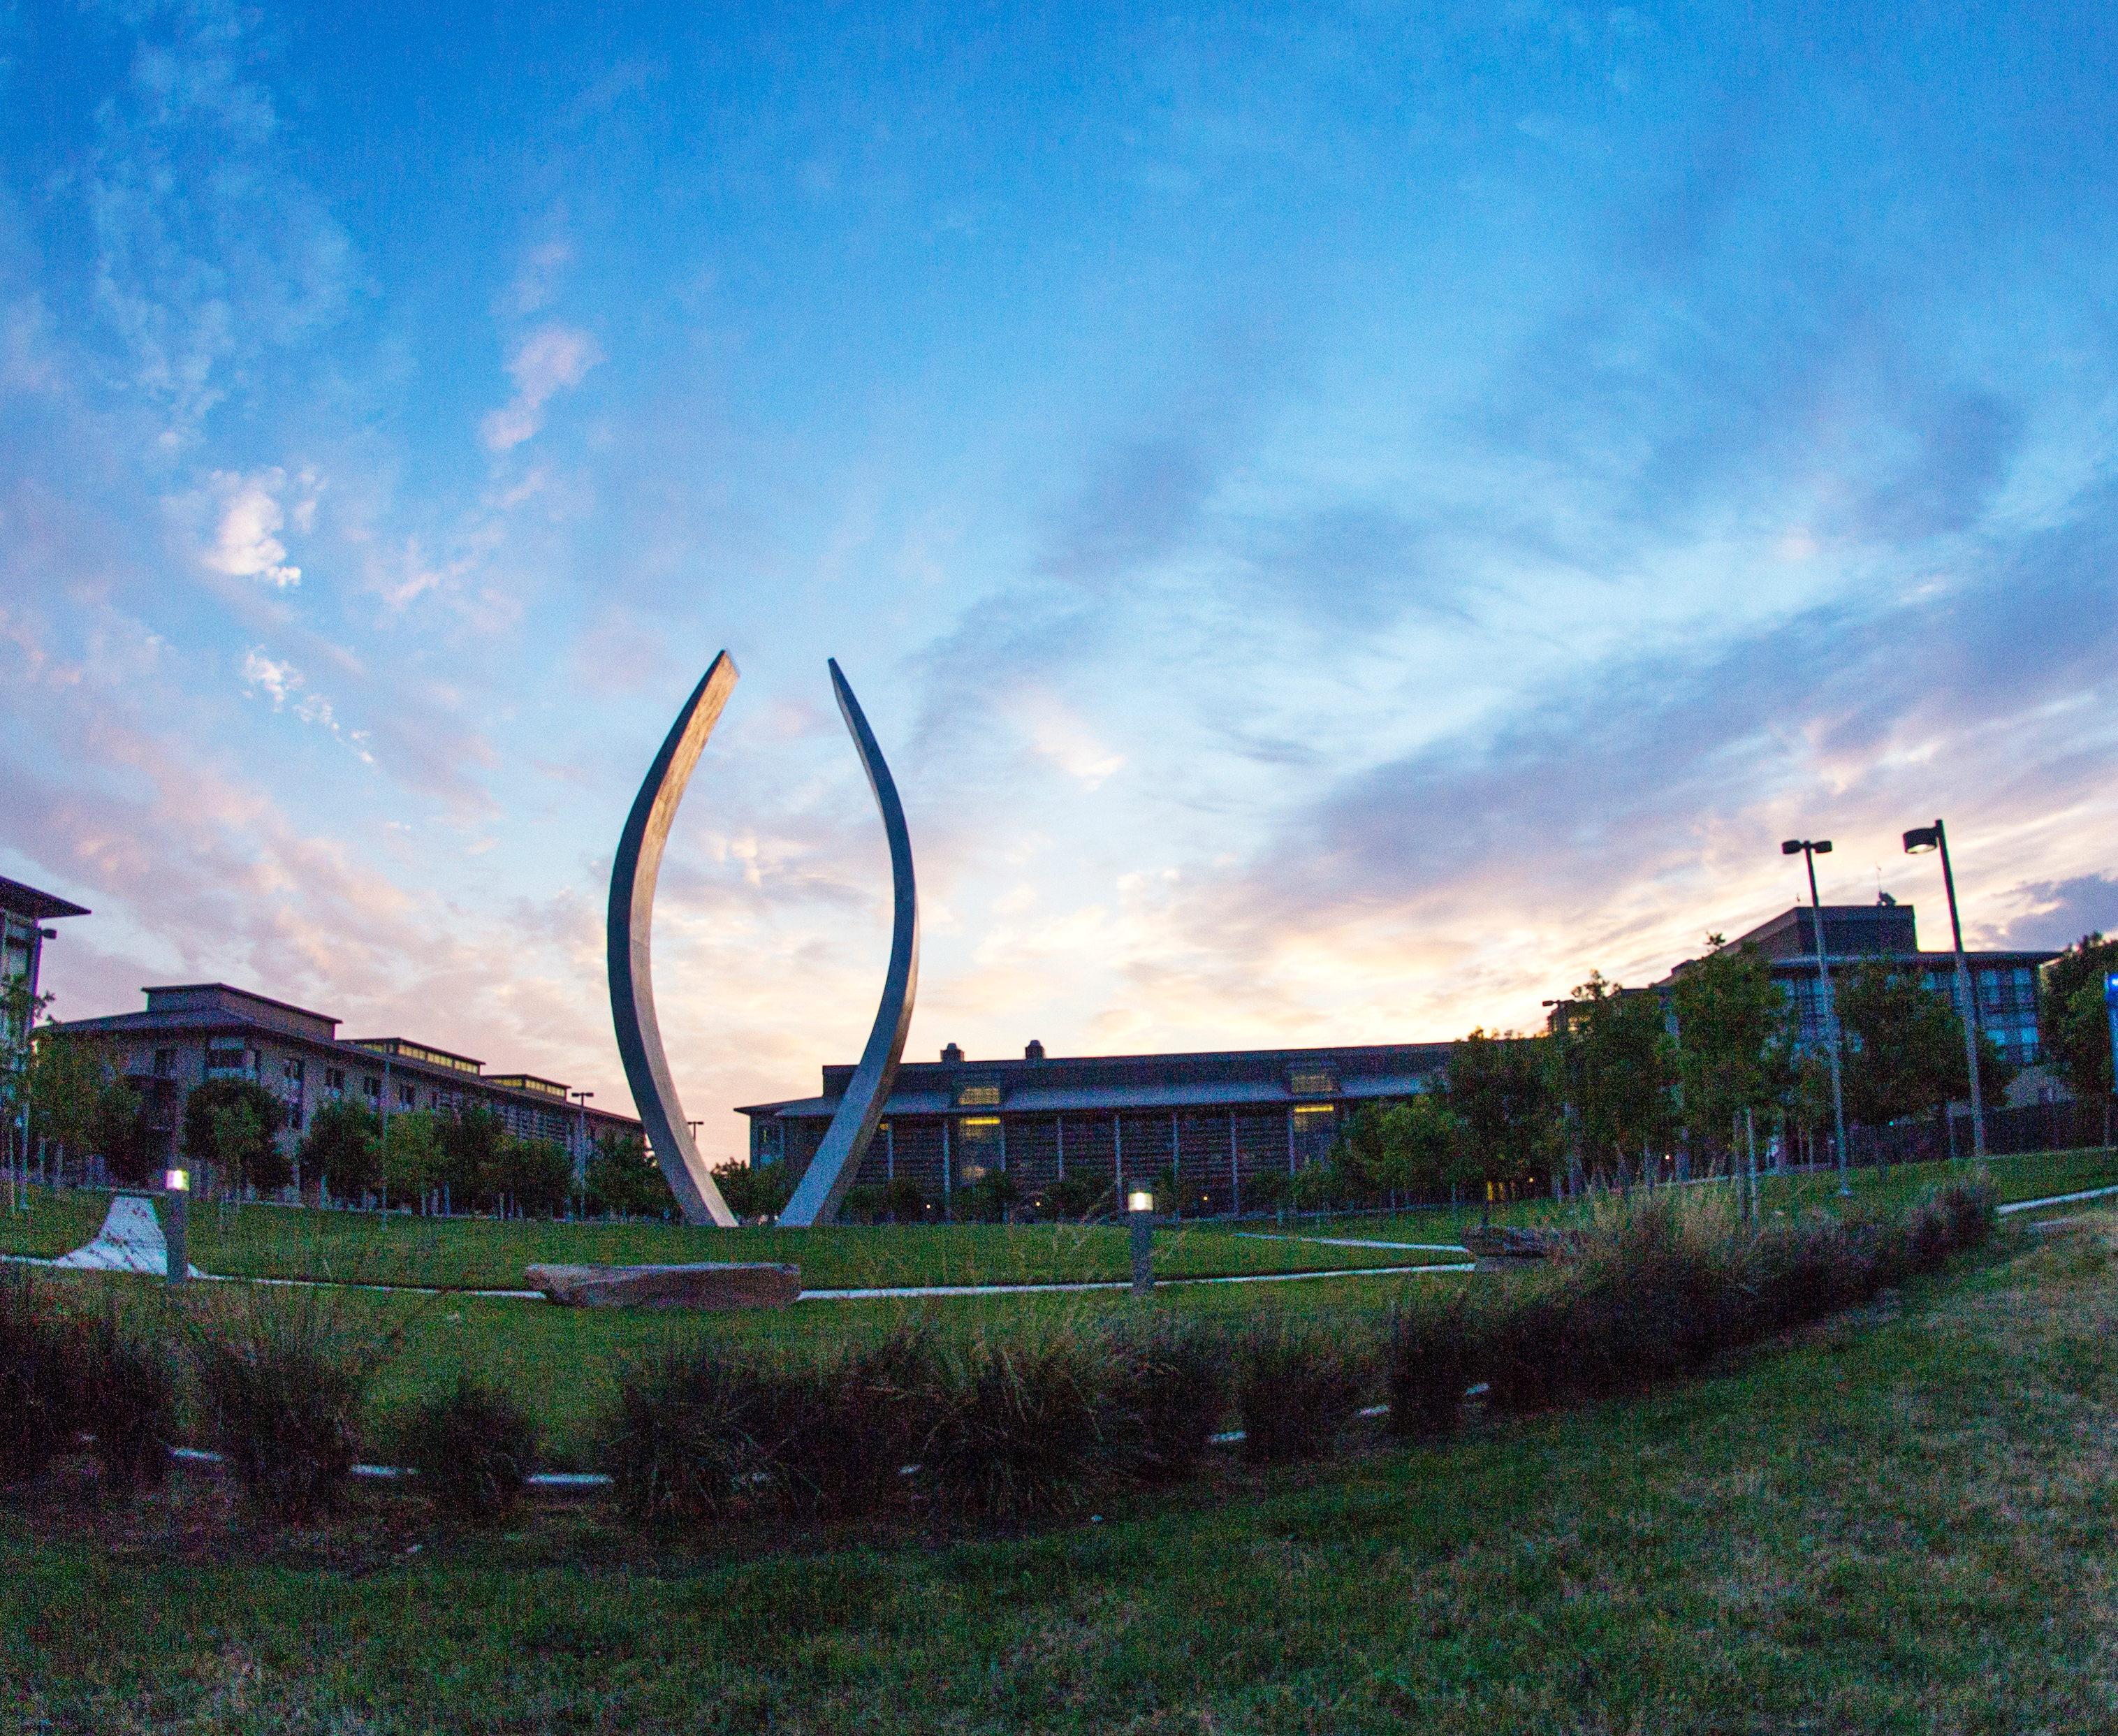
Records Management and Information Practices
Information Practices – California Public Records Act Requests
Subpoena Processing
Records Management Consulting Services

Slide 3

Records Management in a Nutshell
”The field of management responsible for establishing and implementing policies, systems, and procedures to capture, create, access, distribute, use, store, secure, retrieve, and ensure disposition of an organizations records.” – ARMA International, 2010.
In a nutshell: Knowing what records you have, where your records are stored, who has access, and how long you must keep them.
Records Management is about more than paper!
Notes:
The Association of Records Managers and Administrators (ARMA) defines records Management as: “the field of management responsible for establishing and implementing policies, systems, and procedures to capture, create, access, distribute, use, store, secure, retrieve, and ensure disposition of an organizations records.”
At its most basic level, Records Management is about knowing what you have, where it is stored, and how long you must keep it.

Slide 4
Records Management Policies
RMP-1: University Records Management Program
RMP-2: Records Retention and Disposition
RMP-4: Vital Records Protection
RMP-7: Privacy of and Access to Information Responsibilities

Slide 5
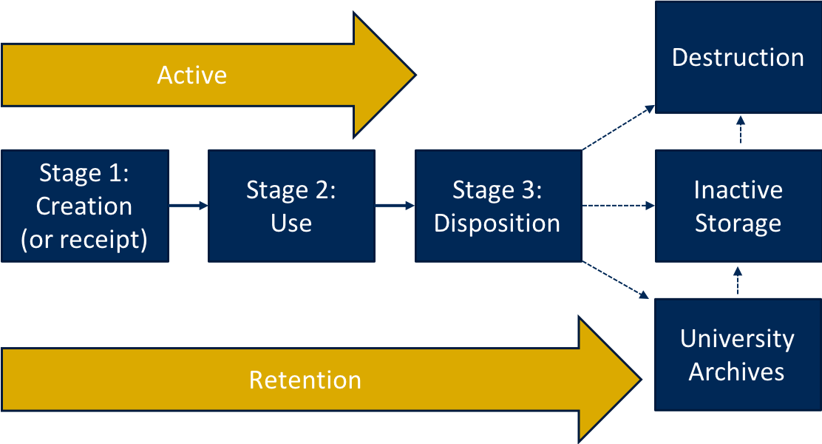
Records Lifecycle
BFB RMP-2: Records Retention and Disposition: Principles, Processes, and Guidelines

Slide 6

Gaining Control of Your Records: A Step-by-Step Approach
Step 1: Records Inventory
Step 2: Identify Non-records
Step 3: Identify Records
Step 4: Identify the records retention period
Notes:
So you have this concept of the records lifecycle, now how do you put it into practice?

Slide 7
Step 1: Records Inventory
A systematic process for identifying records and non-record information within your department or unit.
Record Type
Date range
Format
Volume
Storage Location
Record retention information

Slide 8
Step 2: Identify Non-Records
“Material that is of immediate value only. Non-records are not maintained as university administrative records, are not assigned retention periods, and are not subject to records disposition guidelines.”
Delete/destroy those that are no longer being needed.
Business and Financial Bulletin RMP-2: Records Retention and Disposition: Principles, Processes, and Guidelines

Slide 9
Examples of Non-records…
Envelopes and routing slips
Data entry-sheets and worksheets
Rough drafts or preliminary copies
Multiple copies of publications
Blank forms
Notes or recordings that have been transcribed

Slide 10





Step 3: Identify Records
“Any writing, regardless of physical form or characteristics, containing information relating to the conduct of the public’s business prepared, owned, used, or maintained by an operating unit or employee of the university.” - RMP-2: Records Retention and Disposition: Principles, Processes, and Guidelines
Evidence of a transaction or business decision.
Email
Notes
Database
Electronic File
Formal Document

Slide 11
Active/Inactive Records
Active Records: Records which are still actively being used by an office.
Inactive Records: Records which are no longer referenced on a regular basis.
Active Records
Inactive Records

Slide 12
Step 4: Identify the Records Retention Period
Records Retention Schedule - Policy document that spells out how long different types of records are to be held and how they will be archived or disposed of at the end of their lifecycle.
Following retention requirements reduces liability from public records requests, audits, and litigation.
Makes it easier to retrieve records which are needed by removing those which are redundant, obsolete, or transitory (ROT).
Eliminate costs of storing and maintaining records eligible for disposition.
https://recordsretention.ucop.edu/

Slide 13
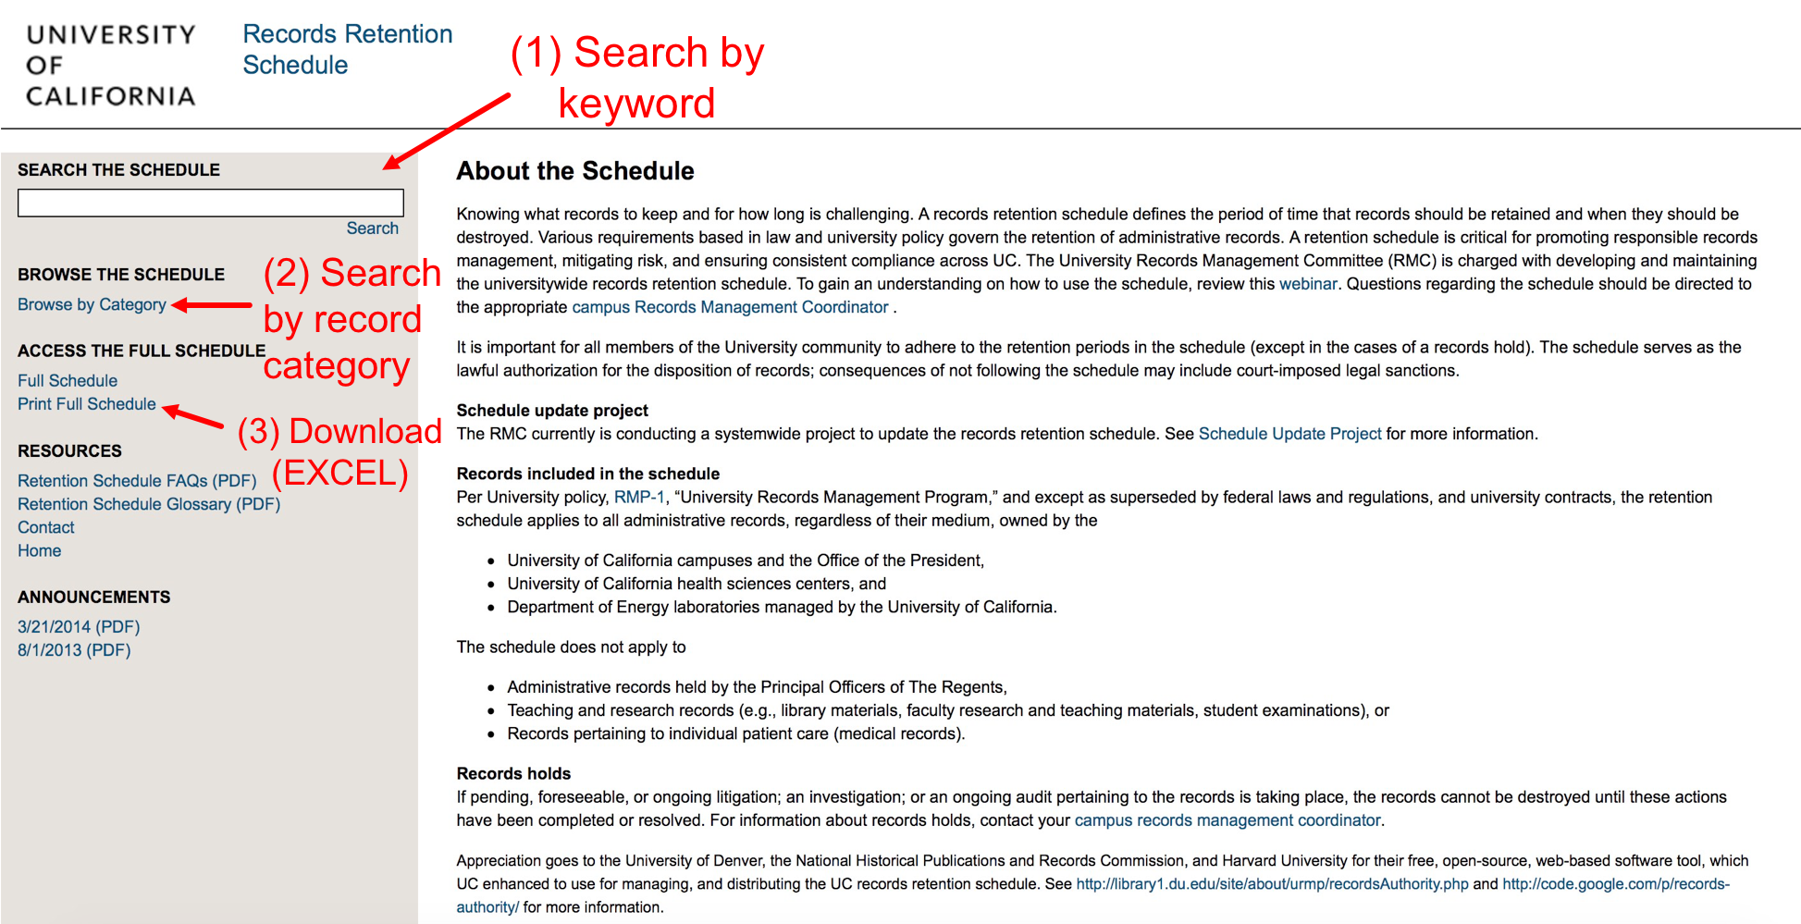
UC Records Retention Schedule
https://recordsretention.ucop.edu/

Slide 14
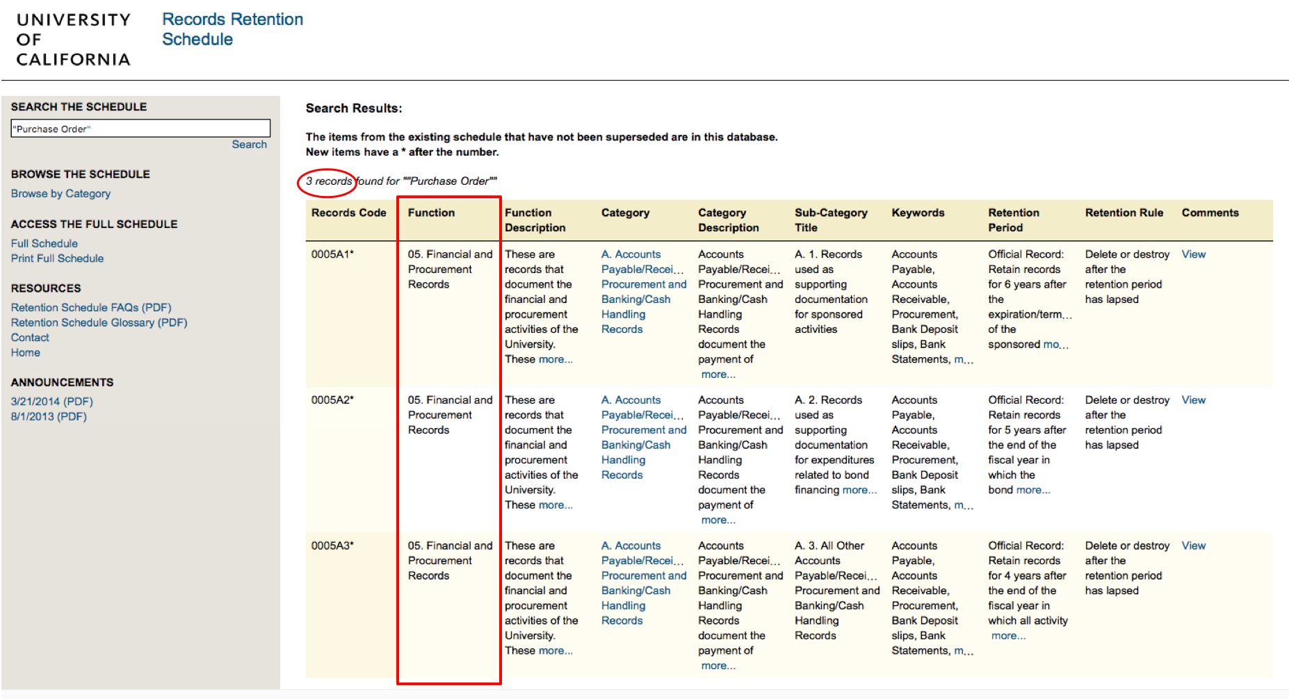
Keyword Search with Quotes
https://recordsretention.ucop.edu/

Slide 15
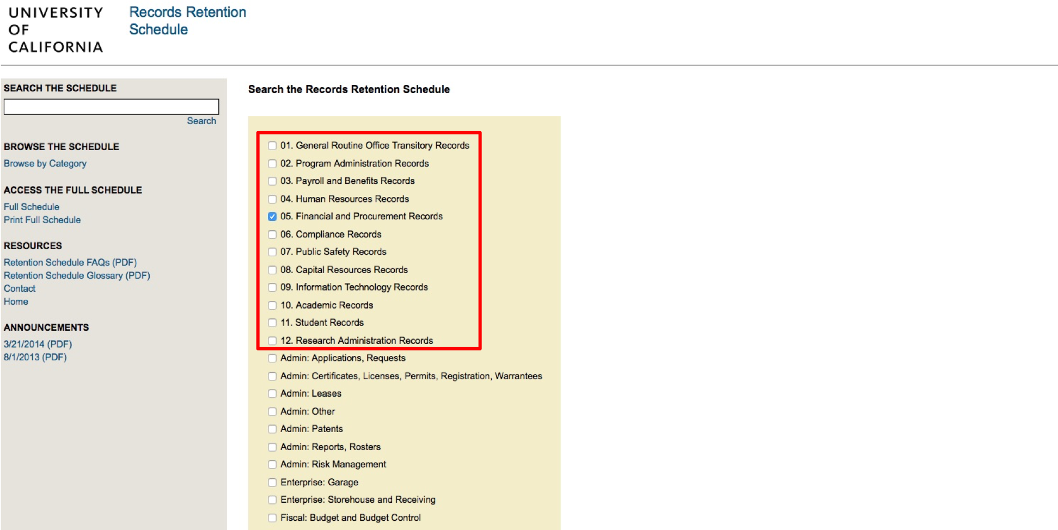
Searching by Record Function
https://recordsretention.ucop.edu/

Slide 16
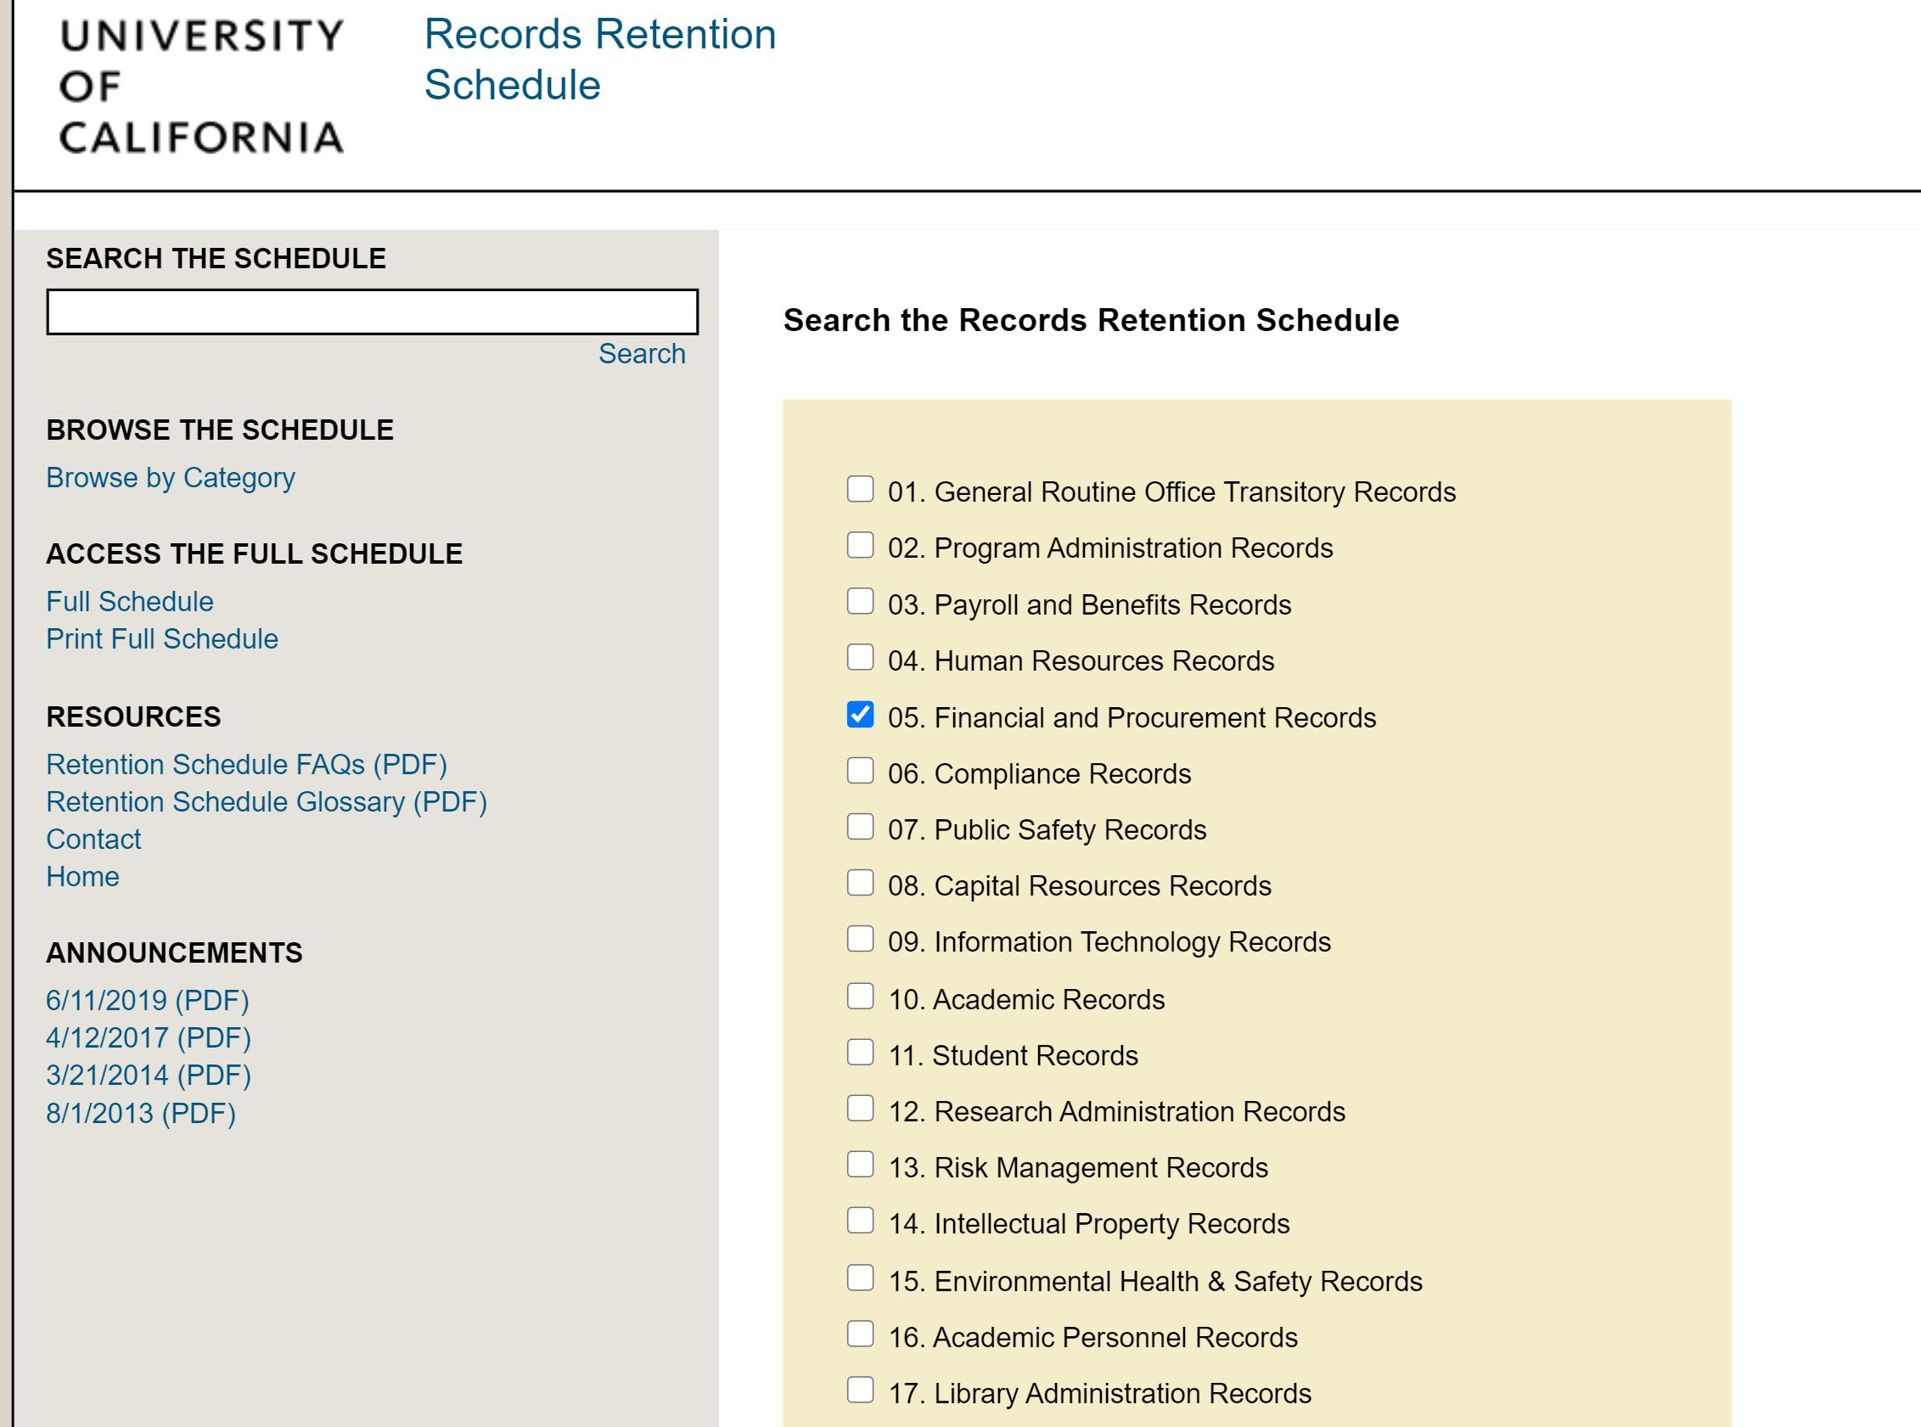
Search Results: Ok, Now What?
https://recordsretention.ucop.edu/

Slide 17
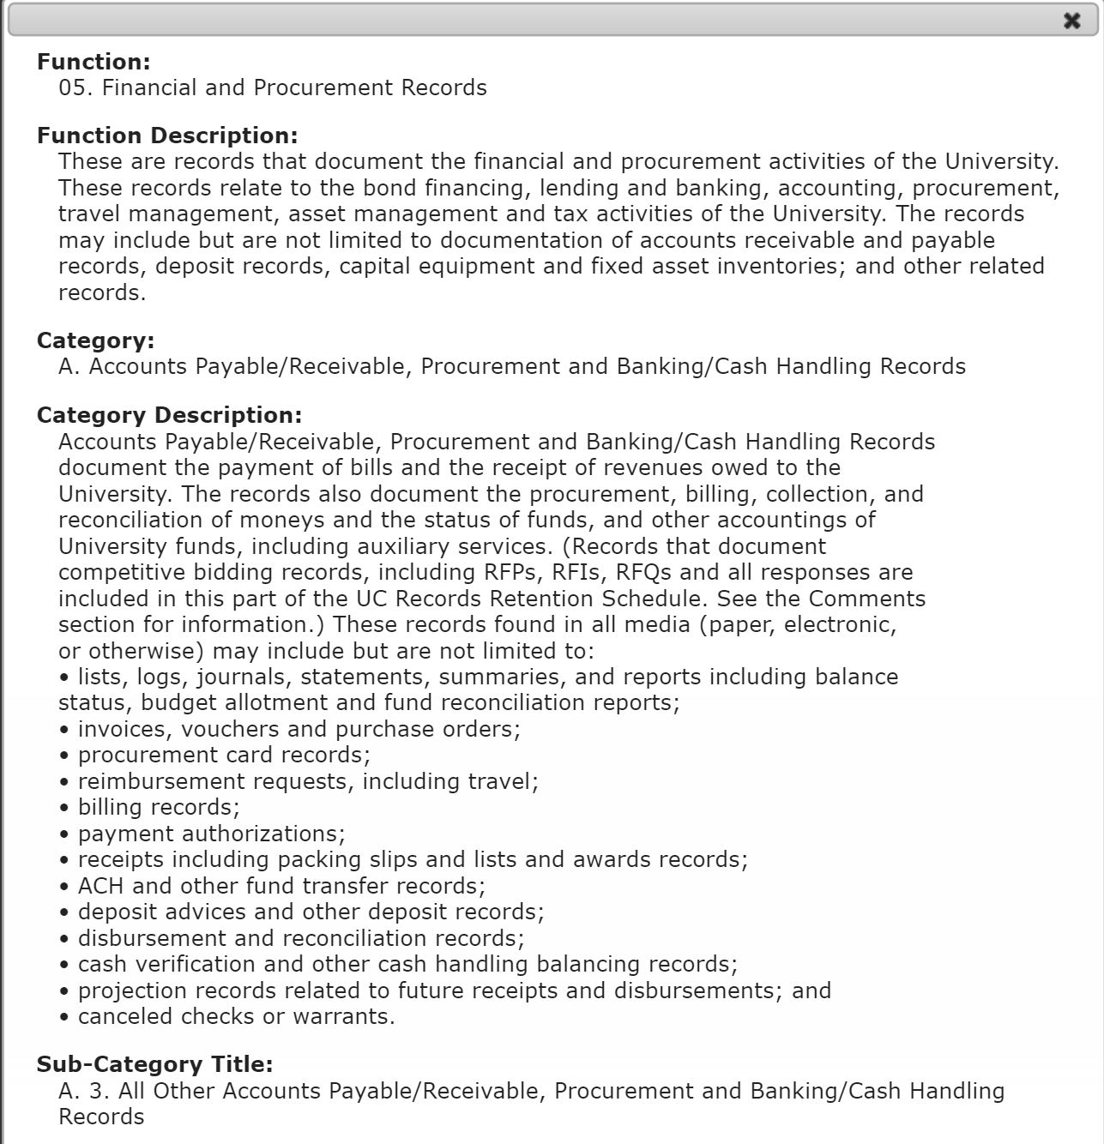
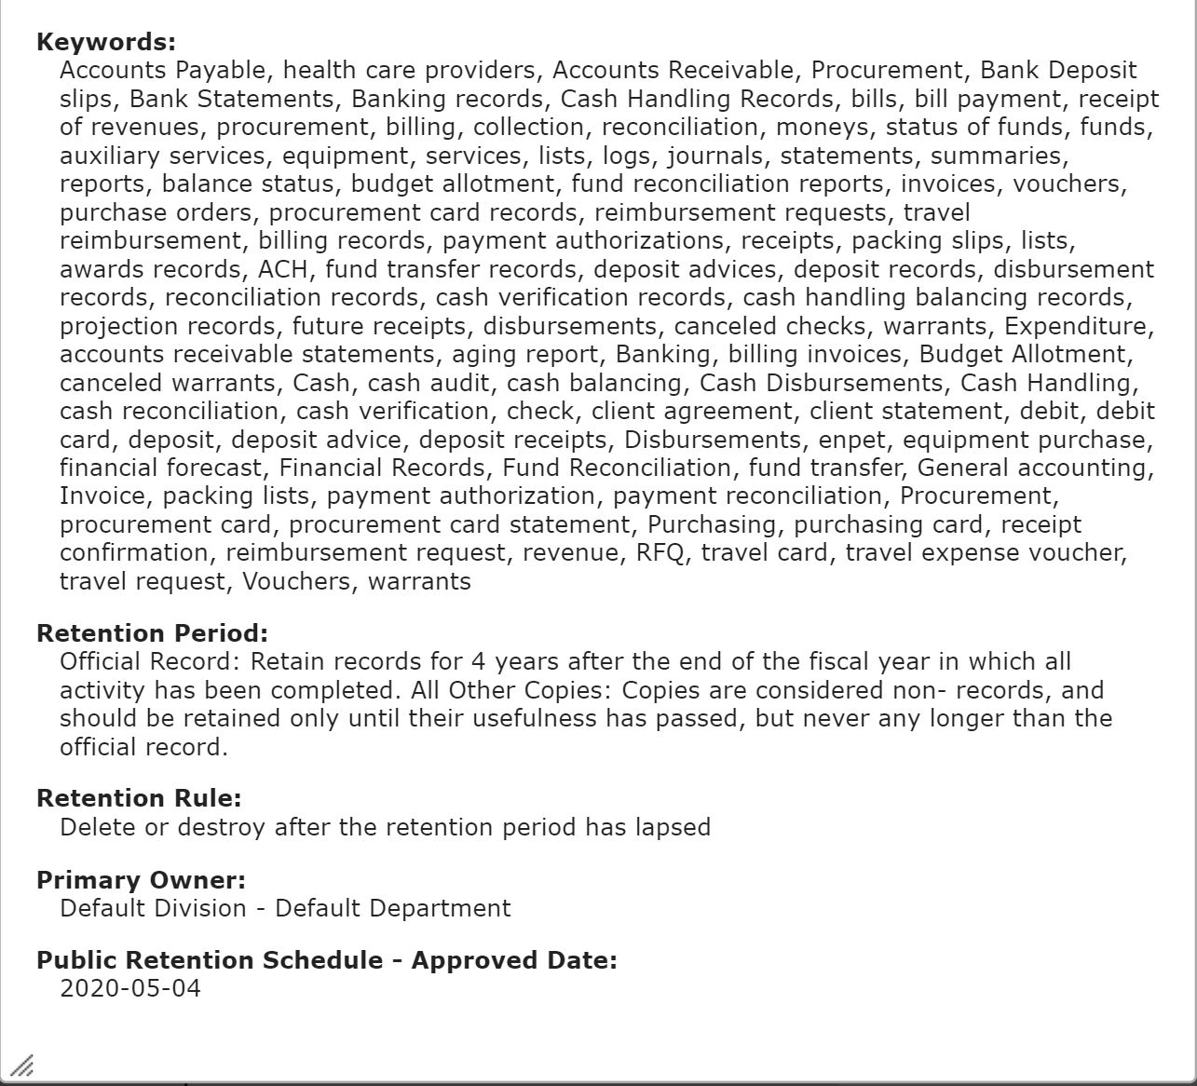
https://recordsretention.ucop.edu/

Slide 18
Cautions Regarding Records Destruction
Records destruction must take into account the nature of the records content.
The records cannot be destroyed if there is:
An open Public Records Act Request that pertains to the records in question
Pending, foreseeable, or ongoing litigation;
An investigation; or
Ongoing audit pertaining to the records

Slide 19
Records Retention FAQs
The UC Records Retention Schedule does not apply to:
  Administrative records held by the Principal Officers of The Regents,
  Teaching and research records (e.g. faculty research and teaching materials, student examinations), or
  Records pertaining to individual patient care (medical records)
The Schedule is media neutral and applies to all administrative records – electronic or paper

Slide 20
Eric Kalmin
Director, Records Management & Information Practices ekalmin@ucmerced.edu
Phone: (209) 285-8708

